Slide 1
Chapter 9. Forecasting
9.0 Conditional Expectation
9.1 Minimum Mean Square Error Forecasting
9.2 Deterministic Trends
9.3 ARIMA Forecasting
9.4 Prediction Limits
9.5 Forecasting Illustrations
9.8 Forecasting Transformed Series

Slide 2
9.0 Conditional Expectation
Definition
If X and Y have joint pdf f(x, y) and we denote the marginal pdf of X by f(x), then the conditional pdf of Y given X = x is given by
For a given value of x, the conditional pdf has all of the usual properties of a pdf.

Slide 3
9.0 Conditional Expectation
Definition
The conditional expectation of Y given X = x is defined as

Slide 4
9.0 Conditional Expectation
Properties of conditional expectation
Let X, Y and Z be random variables. Let a, b and c be constants.
E(aY + bZ + c| X = x) = aE(Y|X = x) + bE(Z|X = x) + c
E(h(X)|X = x) = h(x)
E(h(X, Y)|X = x) = E(h(x, Y)|X = x)
E[E(Y|X)] = E(Y)
If X and Y are independent, then E(Y|X) = E(Y)

Slide 5
9.1 Minimum Mean Square Error Forecasting
Definition
Based on the available history of the series up to time t, namely Y₁, Y₂, …, Y_{t – 1}, Y_{t}, we would like to forecast the value of Y_{t + l} that will occur l time units into the future. We call time t the forecast origin and l the lead time for the forecast, and denote the forecast itself as
.

Slide 6
9.1 Minimum Mean Square Error Forecasting
Theorem 9.1.1
The function h(Y₁, Y₂, …, Y_{t}) which minimizes
is given by
This is called the minimum mean square error forecast of Y_{t+l}.

Slide 7
9.1 Minimum Mean Square Error Forecasting
Proof
The proof can be divided into two steps.
Step 1
We first show that the constant c which minimize
g(c) = E[(Y – c)²] (P1)
is equal to E(Y).
Proof of Step 1
Since g(c) is quadratic in c and opens upward, solving g ′(c) = 0 will produce the required minimum.

Slide 8
9.1 Minimum Mean Square Error Forecasting
We have
so that the optimal c is
c = E(Y) = μ (P2)
Note also that

Slide 9
9.1 Minimum Mean Square Error Forecasting
Step 2
Now, we want to determine the function h(Y₁, Y₂, …, Y_{t}) which minimizes
From Property (5) of the conditional expectation, we have
Use Property (4) of the conditional expectation, we obtain

Slide 10
9.1 Minimum Mean Square Error Forecasting
Now, h(y₁, y₂, …, y_{t}) is a constant and we apply the result of Eq. (P2) to the conditional distribution of Y_{t+l} given
Y₁ = y₁, Y₂ = y₂, …, Y_{t} = y_{t}. Thus, the best choice of
h(y₁, y₂, …, y_{t}) is

Slide 11
9.1 Minimum Mean Square Error Forecasting
Since this choice of h(y₁, y₂, …, y_{t}) minimizes the inner expectation of Eq. (P5), it must also provide the overall minimum of Eq. (P4). Thus,
♦

Slide 12
9.2 Deterministic Trends
Consider a deterministic trend model
where the stochastic component, X_{t}, has a mean of 0. For this section, we shall assume that {X_{t}} is in fact white noise with variance γ₀.
From Eq. (9.2.1), we have

Slide 13
9.2 Deterministic Trends
or,
since for l ≥ 1, X_{t+l} is independent of Y₁, Y₂, …, Y_{t – 1}, Y_{t} and has expected value 0. Thus, in this case, forecasting amounts to extrapolating the deterministic time trend into the future.

Slide 14
9.2 Deterministic Trends
For the linear trend case,
the forecast is
Note:
This model assumes that the same linear trend persists into the future. It is the lack of statistical dependence between Y_{t + l} and Y₁, Y₂, …, Y_{t – 1}, Y_{t} that prevents us from improving on μ_{t + l} as a forecast.

Slide 15
9.2 Deterministic Trends
For seasonal models,
the forecast is
Thus, the forecast will also be periodic.

Slide 16
9.2 Deterministic Trends
Definition
The forecast error, e_{t}(l), is given by
From Eq. (9.2.4), we have
so that
That is, the forecasts are unbiased.

Slide 17
9.2 Deterministic Trends
Also,
is the forecast error variance for all lead time l.

Slide 18
9.3 ARIMA Forecasting
AR(1)
Consider an AR(1) process with a nonzero mean
Replacing t by t + 1 in Eq. (9.3.1), we have
Given Y₁, Y₂, …, Y_{t – 1}, Y_{t} , we take the conditional expectation of both sides of Eq. (9.3.2) and obtain

Slide 19
9.3 ARIMA Forecasting
From Property 3 of the conditional expectation, we have
Also, since e_{t+1} is independent of Y₁, Y₂, …, Y_{t – 1}, Y_{t} , we obtain

Slide 20
9.3 ARIMA Forecasting
Thus,
In words, a proportion φ of the current deviation from the process mean is added to the process mean to forecast the next process value.

Slide 21
9.3 ARIMA Forecasting
Now, consider a general lead time l. Replacing t by t + l in Eq. (9.3.1) and taking the conditional expectation of both sides produces
since
and e_{t + l} is independent of Y₁, Y₂, …, Y_{t – 1}, Y_{t} , for l ≥ 1.
Eq. (9.3.7) is called the difference equation form of the forecasts.

Slide 22
9.3 ARIMA Forecasting
Eq. (9.3.7), which is recursive in the lead time l, shows how the forecast for any lead time l can be built up from the forecasts for shorter lead times by starting with the initial forecast computed using Eq. (9.3.6).
Iterating backward on l on Eq. (9.3.7), we have

Slide 23
9.3 ARIMA Forecasting
The current deviation from the mean is discounted by a factor φ^{l}, whose magnitude decreases with increasing lead time. The discounted deviation is then added to the process mean to produce the lead l forecast.
Numerical Example
By using the maximum likelihood estimation, the estimated AR(1) model is given by:
Given that the last observed value of Y_{t} is 67.

Slide 24
9.3 ARIMA Forecasting
From Eq. (9.3.6), we have
From Eq. (9.3.7), we have
From Eq. (9.3.8), we can deduce
We see that is very near μ (= 74.3293).

Slide 25
9.3 ARIMA Forecasting
In general, since |φ| < 1, we have simply
One-Step-Ahead Forecast Error
From Eqs. (9.3.2) and (9.3.6), we have the one-step-ahead forecast error e_{t}(1) as given by

Slide 26
9.3 ARIMA Forecasting
From Eq. (9.3.10), we observe that
The white noise {e_{t}} can be reinterpreted as a sequence of one-step-ahead forecast errors.
The forecast error e_{t}(1) is independent of the history of the process Y₁, Y₂, …, Y_{t – 1}, Y_{t} up to time t.
Var(e_{t}(1)) = σ_{e}². (9.3.11)
We recall that the general linear process of an AR(1) process which is given by
Then Eqs. (9.3.8) and (9.3.12) together yield

Slide 27
9.3 ARIMA Forecasting
Using the ψ-weight as in the general linear process (4.1.1), Eq. (9.3.13) can be rewritten as
where ψ_{j} = φ^{j} for j =1, 2, …, l – 1.

Slide 28
9.3 ARIMA Forecasting
Note that E(e_{t}(l)) = 0; thus the forecasts are unbiased. From Eq. (9.3.14), we have
We see that the forecast error variance increases as the lead l increases (compare with Eq. (9.2.5)).
For AR(1) case,

Slide 29
9.3 ARIMA Forecasting
For long lead times (large l), we have
or, by Eq. (4.3.3),

Slide 30
9.3 ARIMA Forecasting
MA(1)
Consider an MA(1) process with a nonzero mean:
Replacing t by t + 1 and taking conditional expectations of both sides, we have

Slide 31
9.3 ARIMA Forecasting
However, for an invertible model. Eq. (4.5.1) shows that e_{t} is a function of Y_{t}, Y_{t – 1}, … and so we may have the following approximate equation
As in practice, t is large and the model is invertible, the error in the approximation in Eq. (9.3.20) will be very small.
Remark
Eq. (9.3.20) is invalid for non-invertible model.

Slide 32
9.3 ARIMA Forecasting
The one-step-ahead forecast for an invertible MA(1) can be obtained from Eqs. (9.3.19) and (9.3.20) and given as follow
The computation of e_{t} will be a by-product of estimating the parameters in the model.
The one-step-ahead forecast error is

Slide 33
9.3 ARIMA Forecasting
For longer lead times, we have
But, for l > 1, both e_{t+l} and e_{t+l–1} are independent of Y₁, Y₂, …, Y_{t – 1}, Y_{t} . Consequently, these conditional expected values are unconditional expected values, namely zero, and we have
By taking ψ₁ = –θ and ψ_{j} = 0 for j > 1, we can obtain e_{t}(l) and Var(e_{t}(l)) from Eqs. (9.3.14) and (9.3.15).

Slide 34
9.3 ARIMA Forecasting
The Random Walk with Drift
To illustrate forecasting with nonstationary ARIMA series, consider the random walk with drift defined by
Here
so that

Slide 35
9.3 ARIMA Forecasting
Similarly, the difference equation form for the lead l forecast is
and iterating backward on l yields the explicit expression
In contrast to Eq. (9.3.9), if θ₀ ≠ 0, the forecast does not converge for long leads but rather follows a straight line with slope θ₀ for all l.

Slide 36
9.3 ARIMA Forecasting
Note
The presence or absence of the constant term θ₀ significantly alters the nautre of the forecast.
For this reason, constant term should not be included in nonstationary ARIMA models unless the evidence is clear that the mean of the differenced series is significantly different from 0.

Slide 37
9.3 ARIMA Forecasting
The forecast error are
which agrees with Eq. (9.3.14) since in this model ψ_{j} = 1 for all j.

Slide 38
9.3 ARIMA Forecasting
So, by Eq. (9.3.15), we have
In contrast to the stationary case, here Var(e_{t}(l)) grows without limit as the forecast lead time l increases.

Slide 39
9.3 ARIMA Forecasting
ARMA(p, q)
The difference equation form for computing forecasts is given by
where
Note: is the true forecast for j > 0, but, for j ≤ 0,

Slide 40
9.3 ARIMA Forecasting
As Eqs. (9.3.28) and (9.3.29) indicate, the noise terms
e_{t–(q–1)}, …, e_{t–1}, e_{t} appear directly in for leads l = 1, 2, …, q.
However, for l > q, the autoregressive portion of the difference equation takes over, and we have
Thus the general nature of the forecast for long lead times will be determined by the autoregressive parameters φ₁, φ₂,…, φ_{p} (and the constant term, θ₀, which is related to the mean of the process).

Slide 41
9.3 ARIMA Forecasting
From Eq. (5.3.3), we have
So, Eq. (9.3.30) can be rewritten as

Slide 42
9.3 ARIMA Forecasting
Theorem 9.3.1
For any stationary ARMA model, decays to zero as l increases, and the long-term forecast is simply the process mean μ as given in Eq. (9.3.9).
Proof
As a function of lead time, in Eq. (9.3.31) follows the same Yule-Walker recursion as in the autocorrelation function ρ_{k} of the process (see Eq. (4.4.9)).
Thus, as in Sections 4.3 and 4.4, the roots of the characteristic equation will determine the general behavior of for large lead times.

Slide 43
9.3 ARIMA Forecasting
In particular, can be expressed as a linear combination of exponentially decaying terms in l (corresponding to the real roots) and damped sine wave terms (corresponding to the pairs of complex roots).
Thus, for any stationary ARMA model, decays to zero as l increases, and the long-term forecast is simply the process mean μ as given in Eq. (9.3.9). ♦

Slide 44
9.3 ARIMA Forecasting
Theorem 9.3.2
Suppose {Y_{t}} satisfies the general ARIMA(p, d, q) model with AR characteristic polynomial φ(x), MA characteristic polynomial θ(x), and constant term θ₀. Then {Y_{t}} can be written as
where
C_{t}(l) is a certain function of Y_{t}, Y_{t–1}, ….
The ψ-weights are defined by the identity
Proof (Not required) (see P.221 of the textbook)

Slide 45
9.3 ARIMA Forecasting
For invertible models with t reasonably large, C_{t}(l) can be well approximated as a certain function of the finite history Y_{t}, Y_{t–1}, …, Y₁. Thus we have

Slide 46
9.3 ARIMA Forecasting
So,
Thus, for a general invertible ARIMA process.
E[e_{t}(l)] = 0 for l ≥ 1 (9.3.32)
and
So, we obtain the same expression as in Eq. (9.3.15).

Slide 47
9.3 ARIMA Forecasting
From Eqs. (4.1.3) and (9.3.33), we see that for long lead times in stationary ARMA models, we have
or

Slide 48
9.3 ARIMA Forecasting
Nonstationary Models
From Eq. (5.2.2), ARIMA(p, 1, q) model can be written as a nonstationary ARMA(p+1, q) model which is given as
where the script coefficients ϕ are directly related to the block φ coefficients. In particular,

Slide 49
9.3 ARIMA Forecasting
For a general order of differencing d, we would have p + d of the ϕ coefficients.
From this representation, we can immediately extend Eqs. (9.3.28) to (9.3.29) to cover the nonstationary cases by replacing p by p + d and φ_{j} by ϕ_{j}.

Slide 50
9.3 ARIMA Forecasting
Example
Consider the ARIMA(1, 1, 1) case
so that
Thus

Slide 51
9.3 ARIMA Forecasting
For the general invertible ARIMA model, the representation given in Theorem 9.3.2 and the calculation following these equations show that we can write
and so
and

Slide 52
9.3 ARIMA Forecasting
However, for nonstationary series, the ψ_{j}-weights do not decay to 0 as j increases.
Example
Random Walk Model: ψ_{j} = 1 for all j.
IMA(1, 1) model: ψ_{j} = 1 – θ for j ≥ 1.
IMA(2, 2) model: ψ_{j} = 1 + θ₂ + (1 – θ₁ – θ₂)j for j ≥ 1.
ARI(1, 1) model: ψ_{j} = (1 – φ^{j+1})/(1 – φ) for j ≥ 1.
So, for any nonstationary model, Eq. (9.3.40) shows that the forecast error variance will grow without bound as the lead time l increases. This fact is consistent with the feature that the distant future of nonstationary series is quite uncertain.

Slide 53
9.4 Prediction Limits
Deterministic Trends
From Eqs. (9.2.2) and (9.2.5), we have
If the stochastic component {X_{t}} is normally distributed, then the forecast error
is also normally distributed. Thus, for a given confidence level 1 – α, we could use a standard normal percentile, z_{1–α/2}, to claim that

Slide 54
9.4 Prediction Limits
or equivalently
Thus we may be (1 – α)100% confident that the future observation Y_{t+l} will be contained within the prediction limits

Slide 55
9.4 Prediction Limits
Example
Consider the forecast of the monthly average temperature on June 1976 in Section 9.2, the estimate of
Thus 95% prediction limits for the average June 1976 temperature are

Slide 56
9.4 Prediction Limits
ARIMA Models
If the white noise terms {e_{t}} in a general ARIMA series each arises independently from a normal distribution, then from Eq. (9.3.38), the forecast error e_{t}(l) will also have a normal distribution. Hence, Eq. (9.4.2) remains valid with
Remark
For large sample sizes, the replacement of and ψ-weights with their estimated values have little effect on the actual prediction limits given in Eq. (9.4.2).

Slide 57
9.4 Prediction Limits
Example
Consider the fitted AR(1) model in P.23 of Chapter 9.
Here, we use φ = 0.5705, μ = 74.3293, and .
Recall Eq. (9.3.16)

Slide 58
9.4 Prediction Limits
For a one-step-ahead prediction, we have
Two steps ahead, we obtain
Notice that this prediction interval is wider than the previous interval.

Slide 59
9.5 Forecasting Illustrations
Deterministic Trends
Exhibit 9.2 displays the last four years of the average monthly temperature time series together with forecasts and 95% forecast limits for two additional years.
The forecast limits are quite close to the fitted trend forecast.

Slide 60
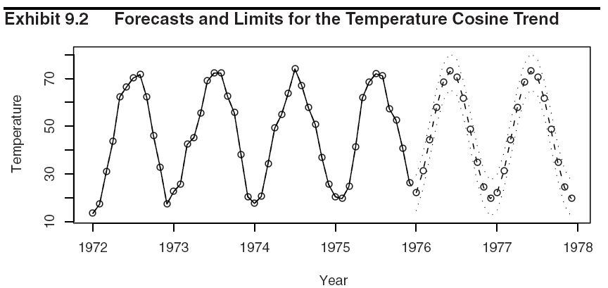
9.5 Forecasting Illustrations

Slide 61
9.5 Forecasting Illustrations
ARIMA Models
Consider the fitted AR(1) model in the numerical example of Section 9.3 (P.23 of Chapter 9).
Exhibit 9.3 displays this series together with forecasts out to lead time 12 with the upper and lower 95% prediction limits for those forecasts.
A horizontal line at the estimate for the process mean is also shown in Exhibit 9.3.
Observation
The forecasts approach the mean exponentially as the lead time increases.
The prediction limits increase in width.

Slide 62
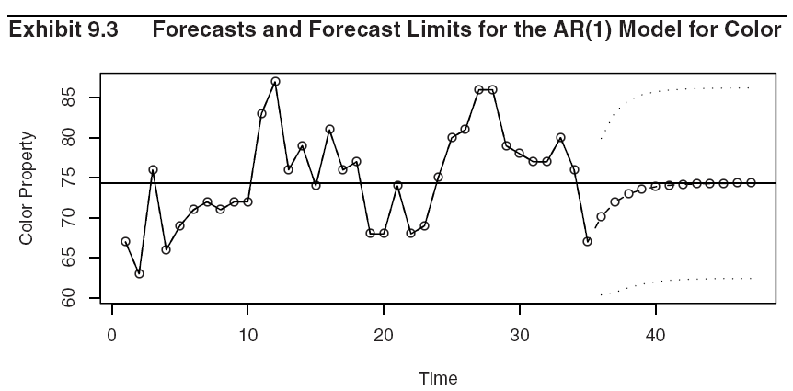
9.5 Forecasting Illustrations

Slide 63
9.8 Forecasting Transformed Series
Differencing
Two methods of forecasting a series whose model involves a first difference to achieve stationarity:
Forecasting the original nonstationary series, for example by using Eq. (9.3.28), with φ’s replaced by ϕ’s throughout.
Forecasting the stationary differenced series
W_{t} = Y_{t} – Y_{t–1} and then “undoing” the difference by summing to obtain the forecast in original terms.

Slide 64
9.8 Forecasting Transformed Series
Both methods lead to the same forecasts because
Differencing is linear operation and
Conditional expectation of a linear combination is the same linear combination of the conditional expectations.

Slide 65
9.8 Forecasting Transformed Series
Example
Consider the IMA(1, 1) model.
Method 1:
Base on the original nonstationary series, we forecast as
and

Slide 66
9.8 Forecasting Transformed Series
Method 2:
Consider now the differenced stationary MA(1) series
W_{t} = Y_{t} – Y_{t–1} . We would forecast W_{t+l} as
and
From Eq. (9.8.3), we have

Slide 67
9.8 Forecasting Transformed Series
From Eq. (9.8.4), we have, for l > 1,

Slide 68
9.8 Forecasting Transformed Series
Log Transformations
Let Y_{t} denote the original series value.
Let Z_{t} = log(Y_{t}).
It can be shown that we always have
with equality holding only in trivial cases.
Thus, from Theorem 9.1.1, the forecast is not the minimum mean square error forecast of Y_{t+l}.

Slide 69
9.8 Forecasting Transformed Series
To evaluate the minimum mean square error forecast in original terms, we shall use the following fact:
If X has a normal distribution with mean μ and variance σ², then
In our case,
and

Slide 70
9.8 Forecasting Transformed Series
Thus the minimum mean square forecast in the original series {Y_{t}} is given by

Slide 71

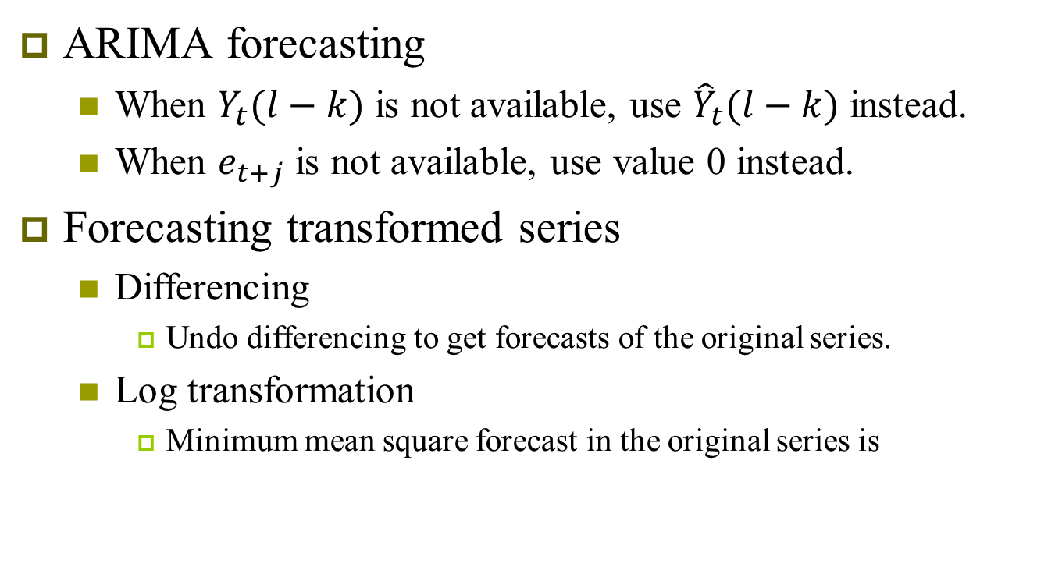
Summary
ARIMA forecasting
  When $Y_{t}(l−k)$ is not available, use ${\hat{Y}}_{t}(l−k)$ instead.
  When $e_{t+j}$ is not available, use value 0 instead.
Forecasting transformed series
  Differencing
    Undo differencing to get forecasts of the original series.
  Log transformation
    Minimum mean square forecast in the original series is

